Slide 1
Use Immune Checkpoint Inhibitors to Activate
Anti-tumor Immune Responses in T Cells
Yuwenbin Li
Evans Lab
01/19/2019

Slide 2
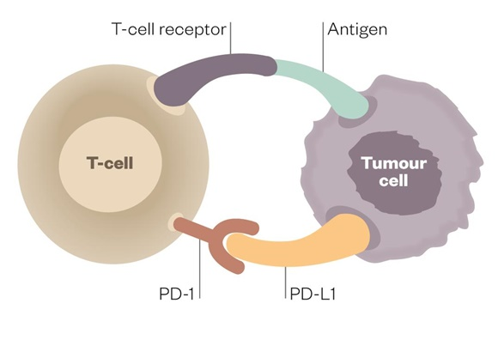

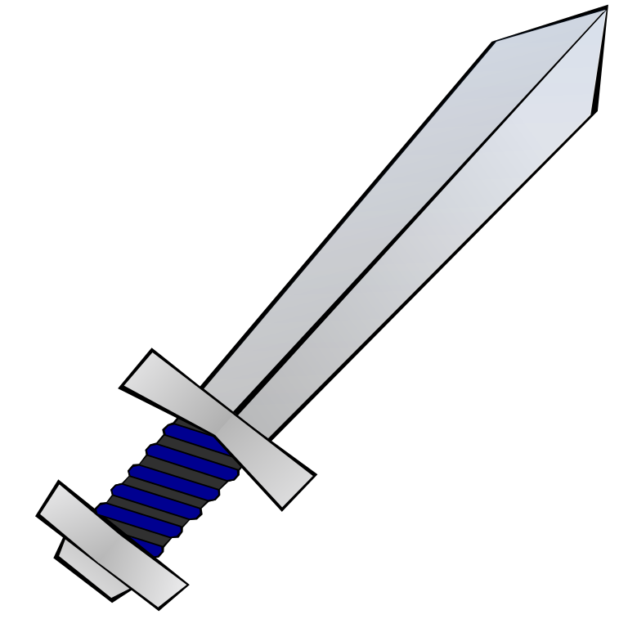
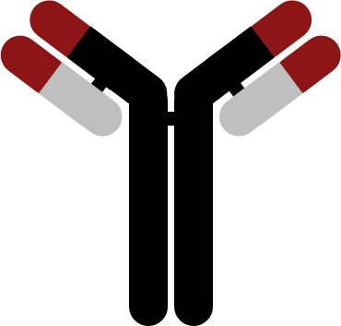
Overall Conception
(Also from other cells)
Immune checkpoint inhibitors

Slide 3
Flow of Content
How do T cells develop and recognize tumor cells
Function of immune checkpoints under normal condition
How tumor cells block anti-tumor immune responses by targeting immune checkpoints in different ways
How immune checkpoint inhibitors work
Current stage of immune checkpoint inhibitor blockage
Future direction of immune checkpoint therapies

Slide 4
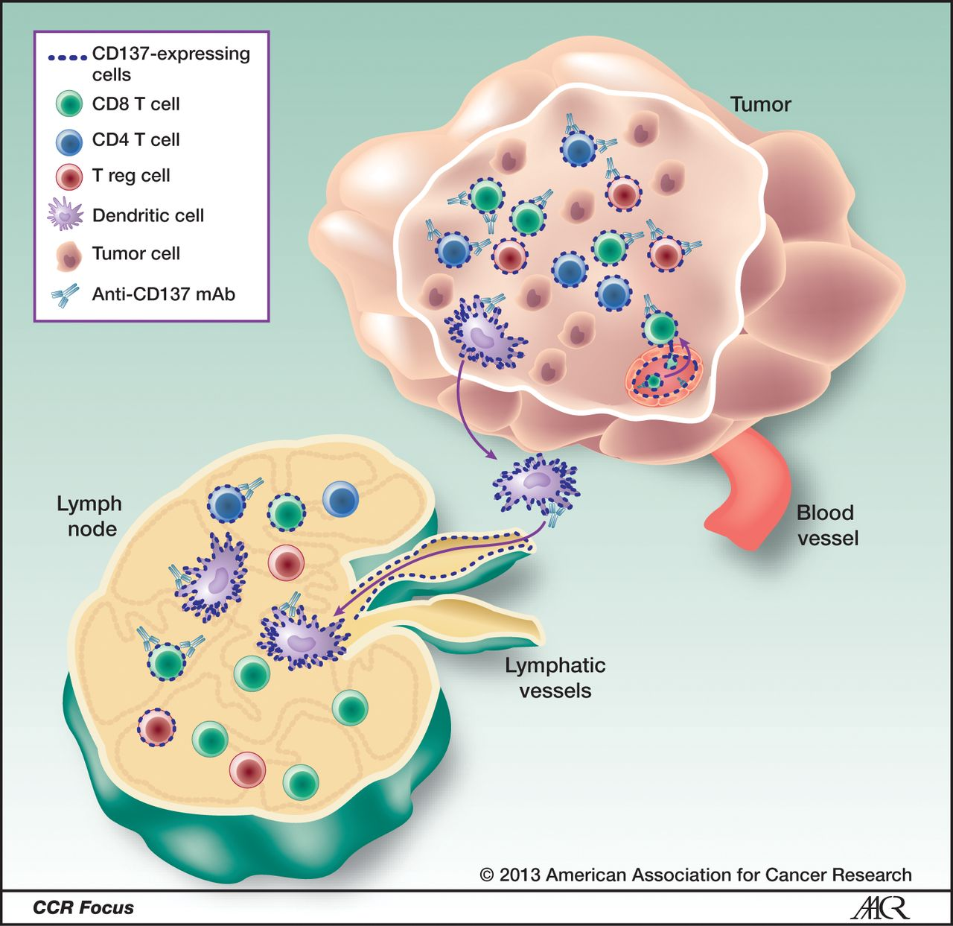
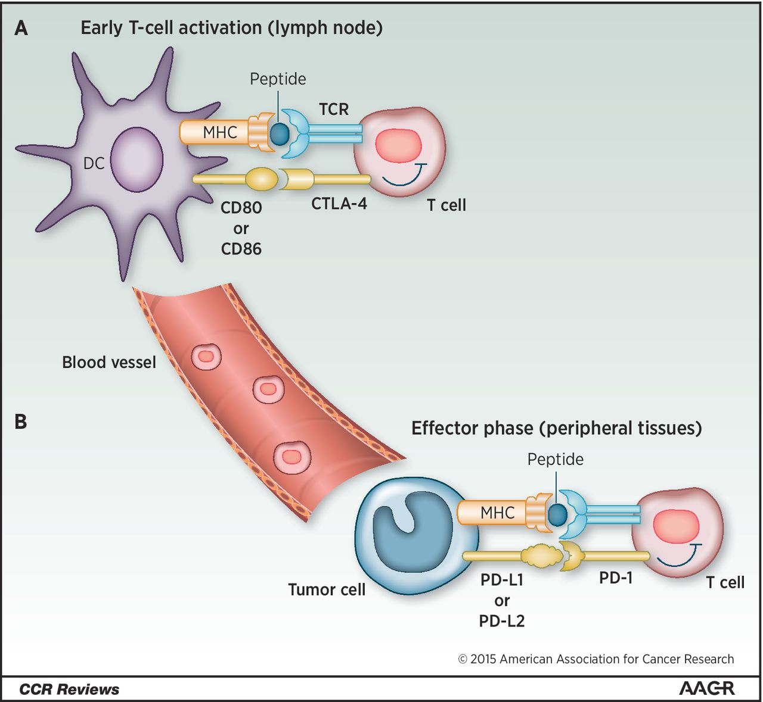

T Cell Development and Recognition of Tumor Cells
DC: Dendritic Cells
Naïve T cell

Slide 5
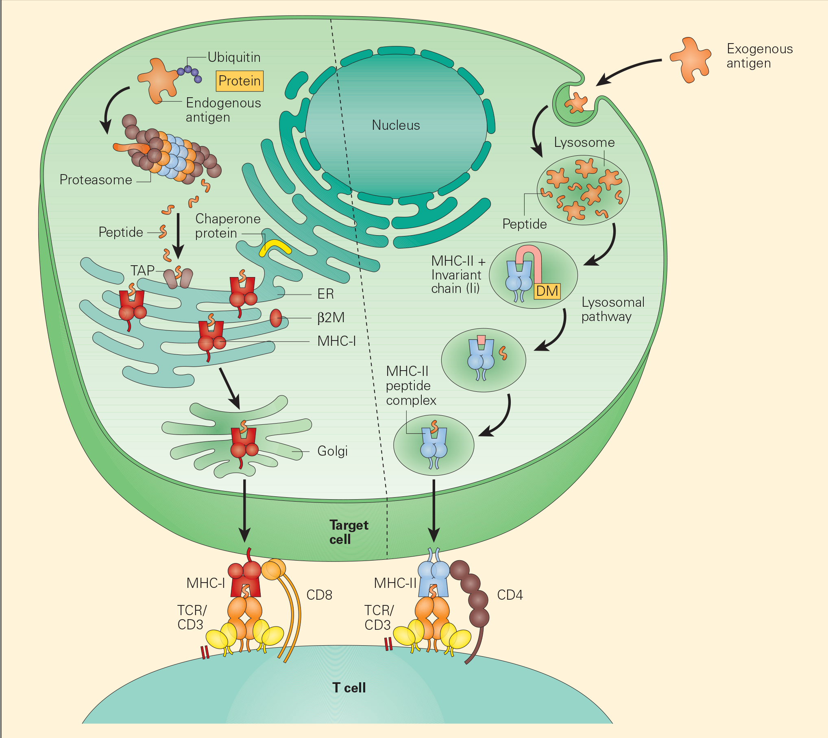

Slide 6
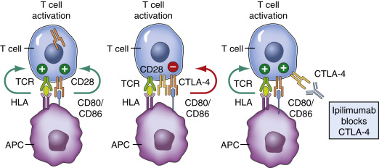
Two Well-known Immune Checkpoints: PD-1 and CTLA-4
CTLA-4 on T cells competes with CD28 for CD80/86 expressed on APCs (including DCs and macrophages)
Secondary lymphoid

Slide 7
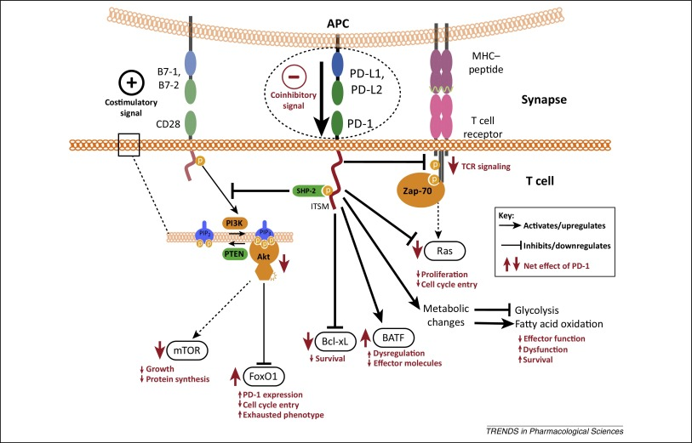
Two Well-known Immune Checkpoints: PD-1 and CTLA-4
Tissue with infection
PD-L1 is mainly expressed on DCs, macrophages (and tumor cells), which interacts with PD-1 on T cells

Slide 8
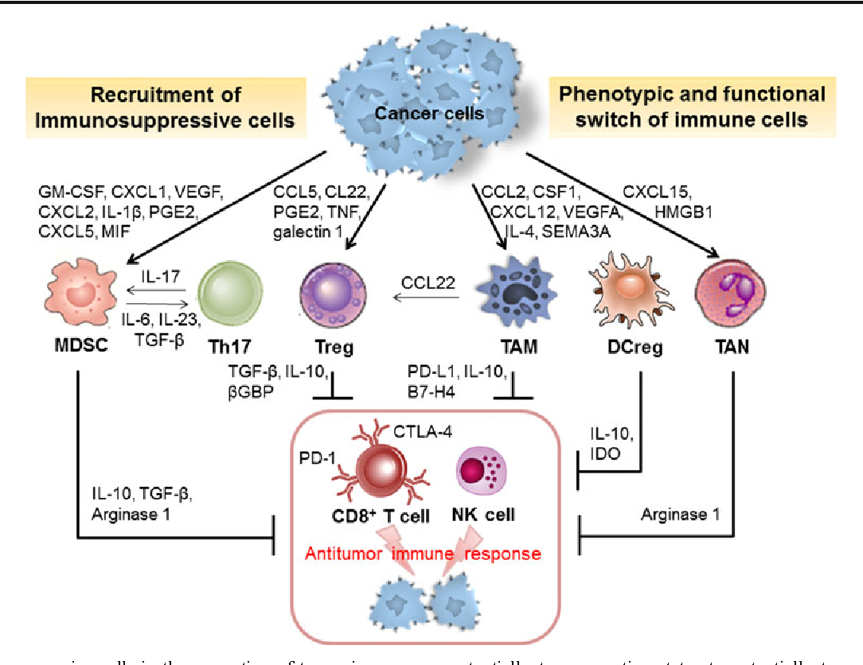
Tumor Cells Rewire Their Microenvironment by Highjacking Immunosuppressive Cells

Slide 9
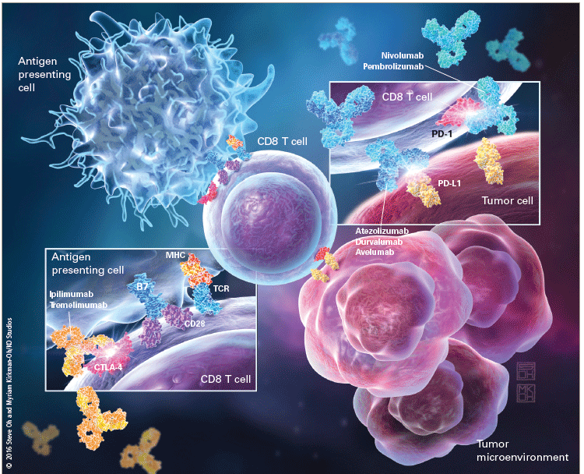
Immune Checkpoint Inhibitors Work by Taking off Brakes from T cells at Different Stages

Slide 10
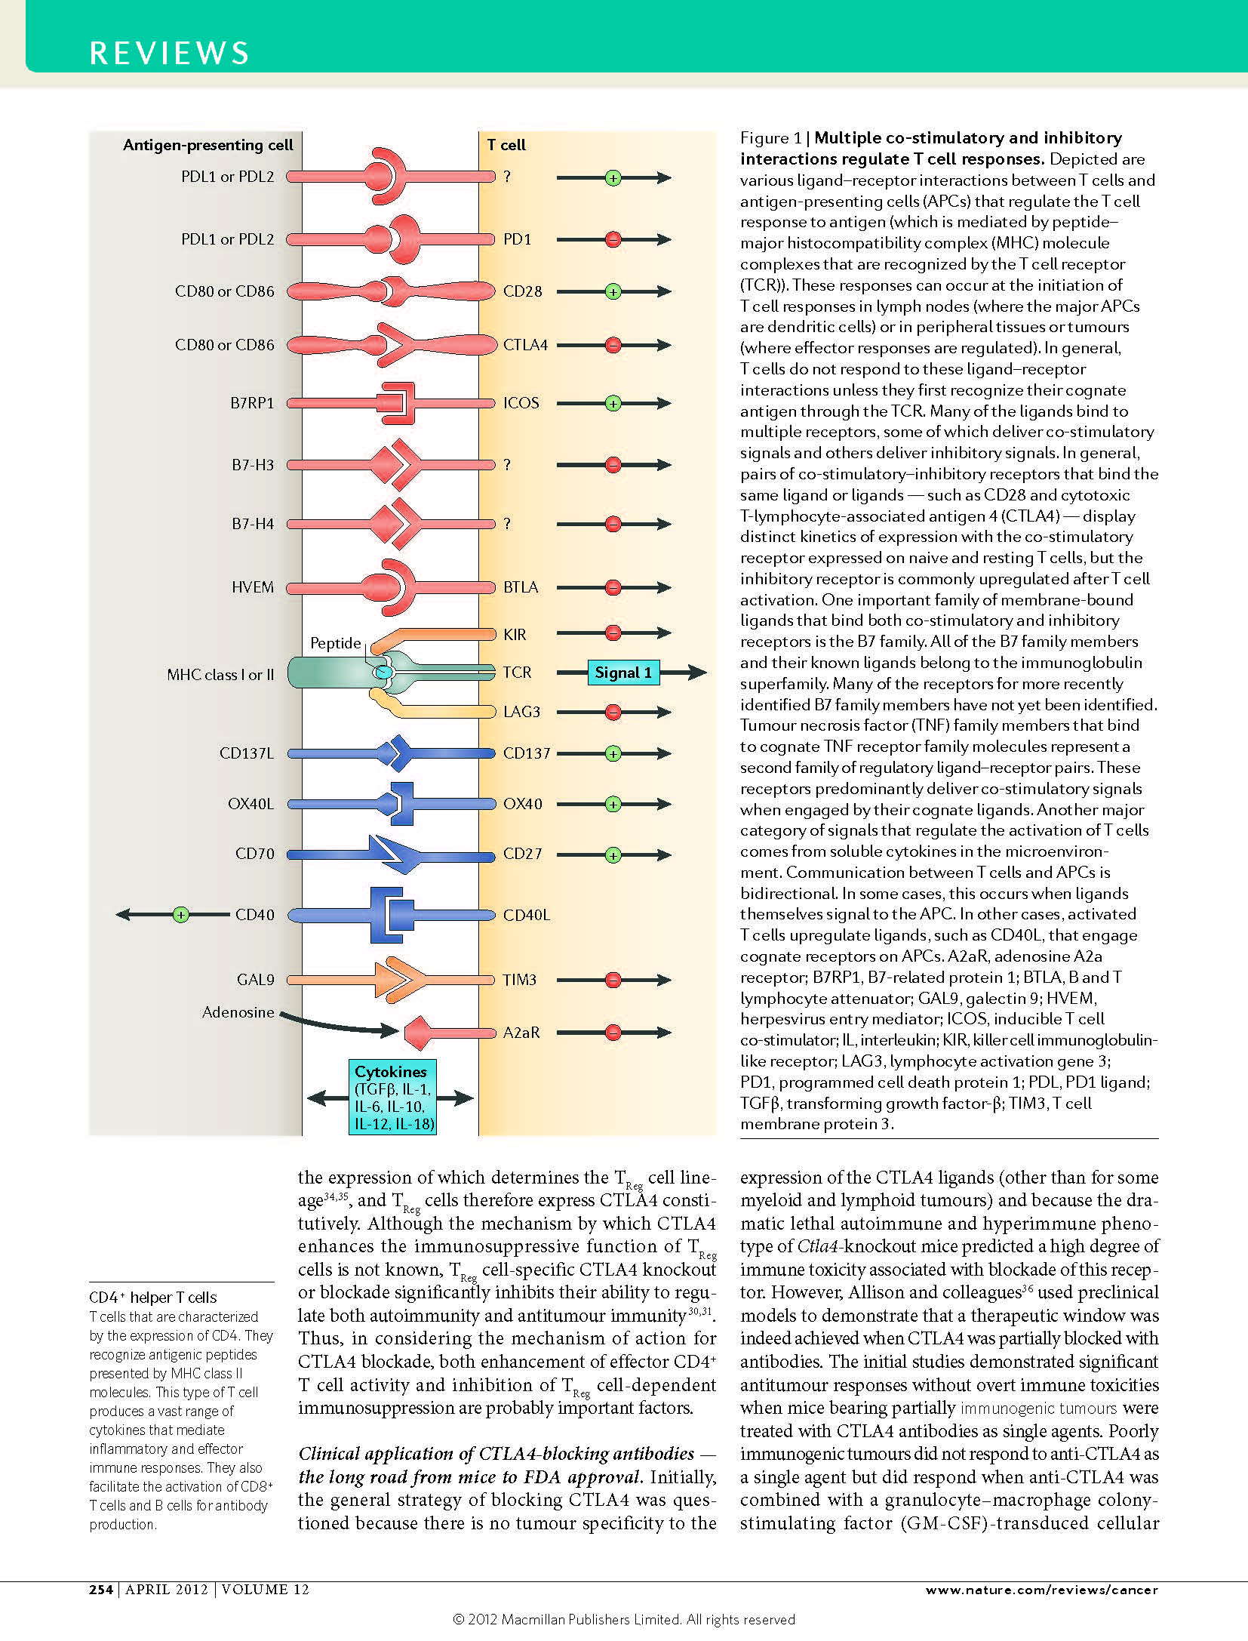
There are Multiple Co-stimulatory and Inhibitory Interaction that Regulate T Cell Responses

Slide 11
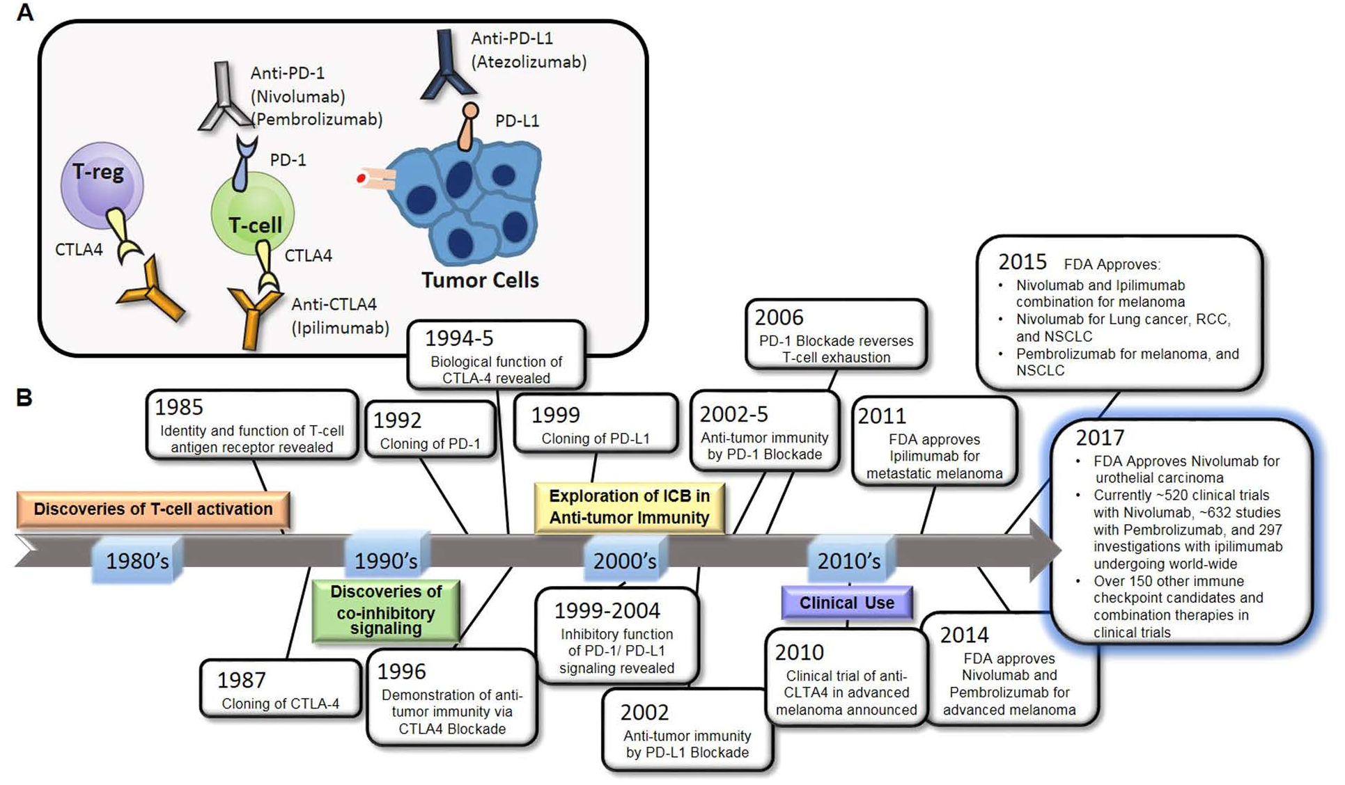
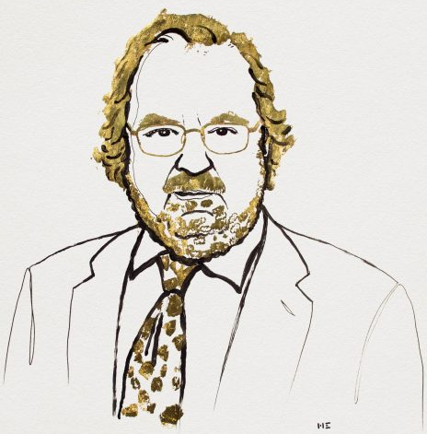

Development of Cancer Treatment Using Immune Checkpoint Blockage
James P. Allison
Tasuku Honjo

Slide 12
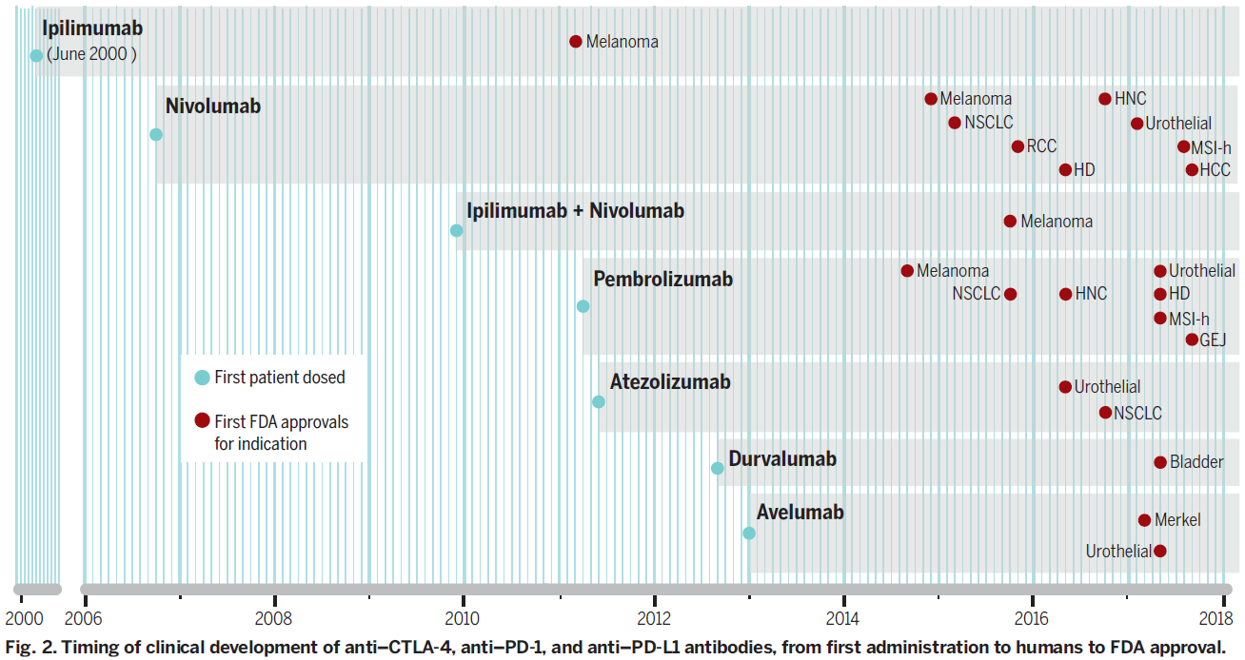
Current Situation of Using Immune Checkpoint Therapies
Anti-CTLA-4
Anti-PD-1
CTLA-4 + PD-1
Anti-PD-1
Anti-PD-L1
Anti-PD-L1
Anti-PD-L1

Slide 13
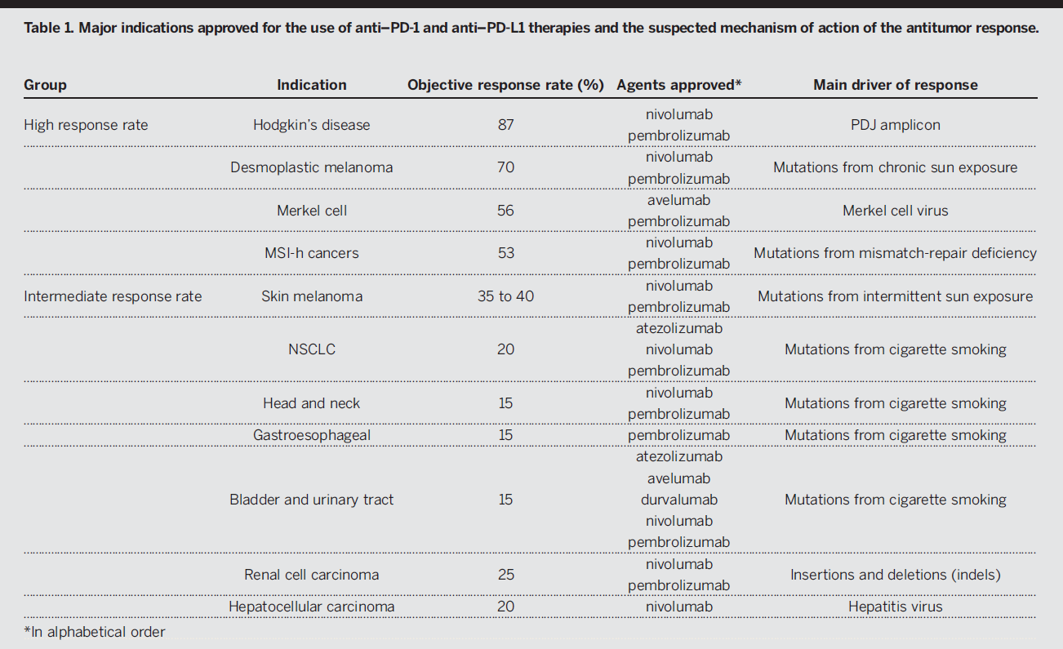
Current Situation of Using Immune Checkpoint Therapies

Slide 14
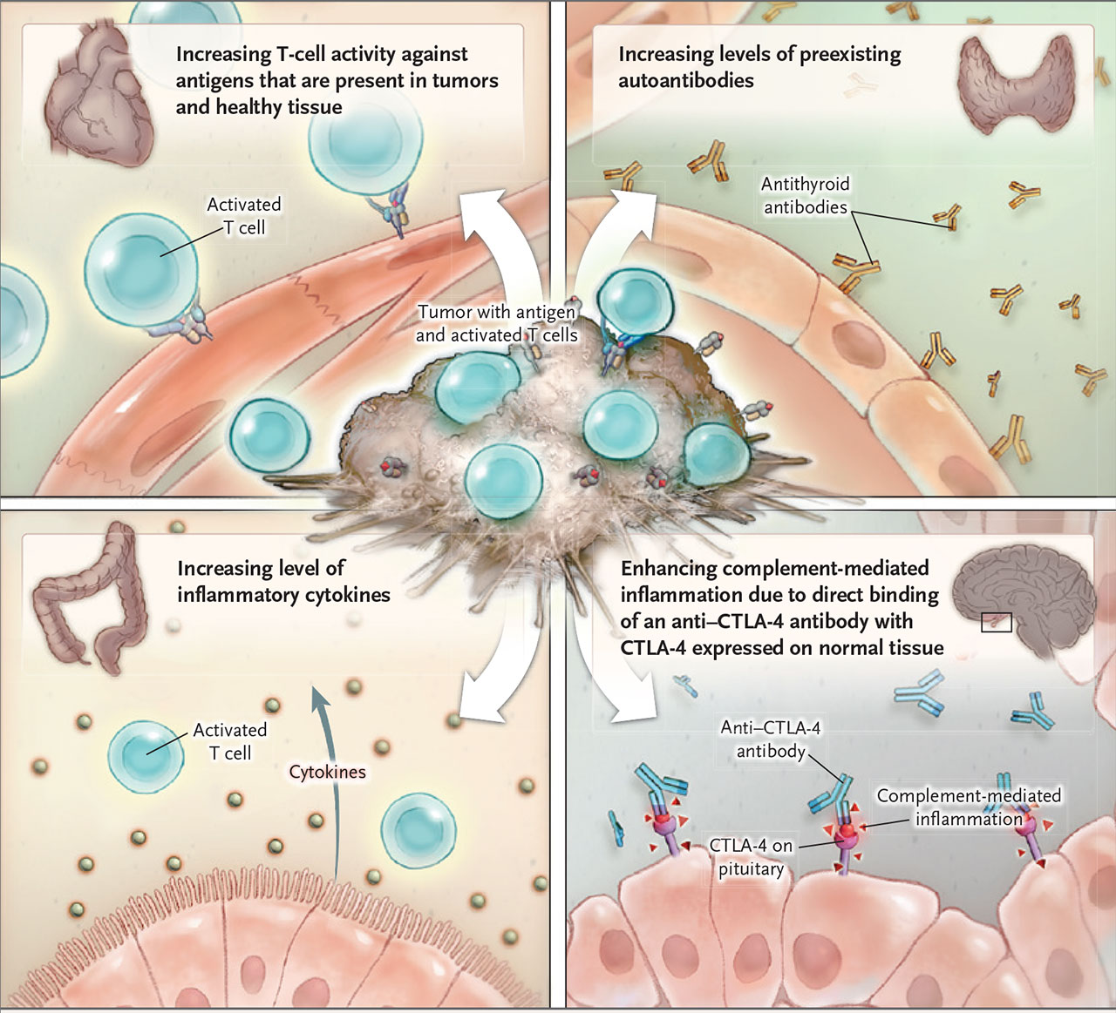
Side-effects of Using Immune Checkpoint Blockage

Slide 15
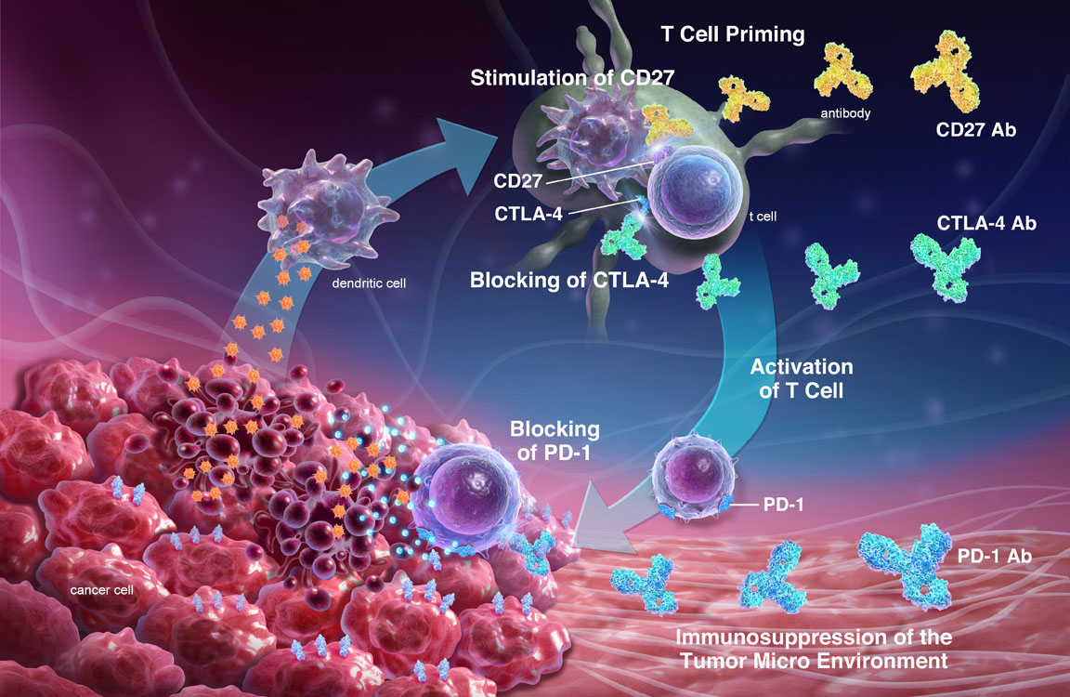
Future Direction of Immune Checkpoint Therapies
Combine multiple immune checkpoint inhibitors (anti-PD-1 + anti-CTLA-4)
Combine immune checkpoint inhibitor with other therapies (chemo, radio)
Make immune checkpoint inhibitors work on more cancer types (PDAC)
Elongate half-life period of antibodies in body
Develop new immune checkpoint inhibitors
Patient specific usage of drugs
Tissue specific delivery of drugs

